Slide 1
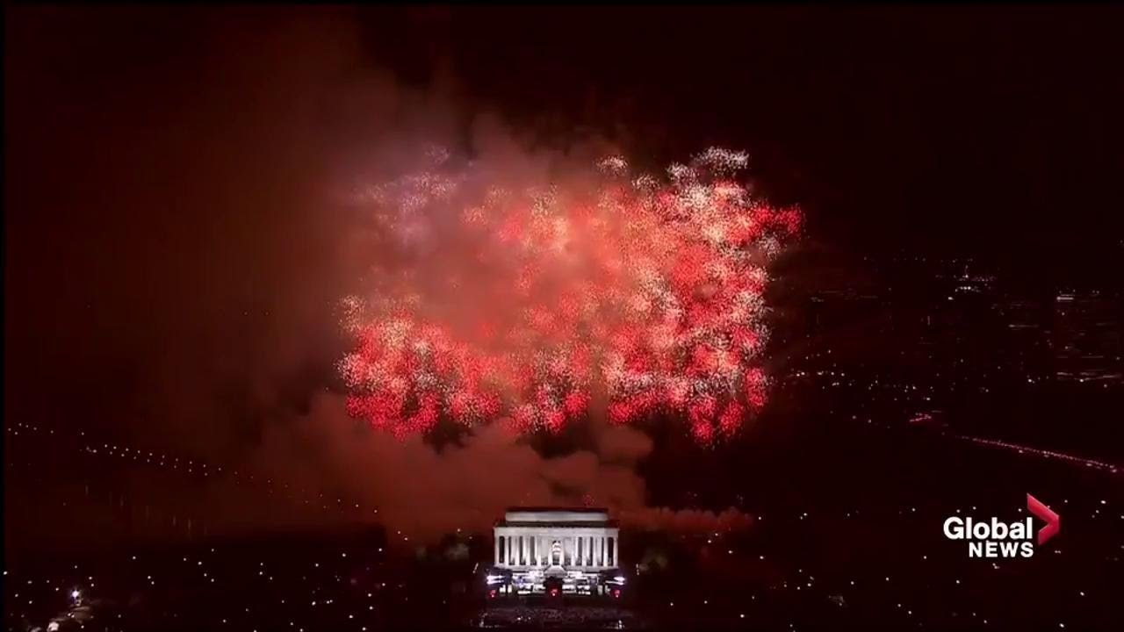
Lincoln Memorial
July 4, 2019

Slide 2
The Blood Covenant:
Divine Providence:
a) Founding Fathers
Restore Kingdom Values
The Ekklesia
Shift in Power and Authority:
Sword – Scepter
The “Vision”
The Fight for Freedom
July is a month that is celebrated for freedom in the United States. The national holiday commemorates the signing of the Declaration of Independence in 1776. The holiday was established to remind the citizens of the price paid to insure a free nation.
Throughout the years since 1776, there has been a fight to secure the freedom that our forefathers shed blood for. Today’s battle for freedom includes the battle against anti-biblical philosophies. There is an attempt to remove freedom from the people and bring them under the subordination of a Pharaoh System of government. God must have His Ecclesia arise and contend for the restoration of Kingdom values. This can be your defining moment!

Slide 3
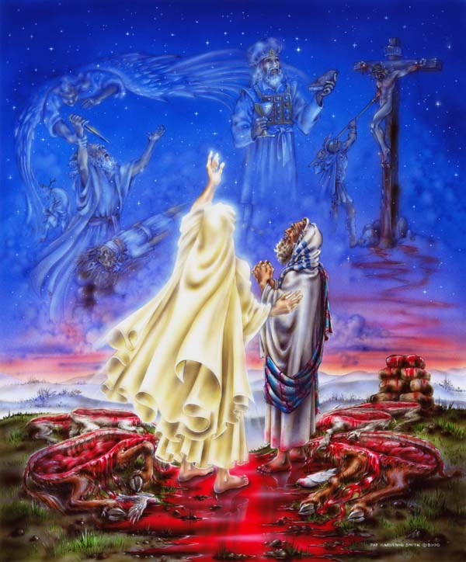
BLOOD COVENANT

Slide 4
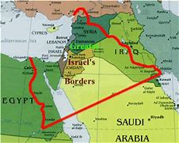
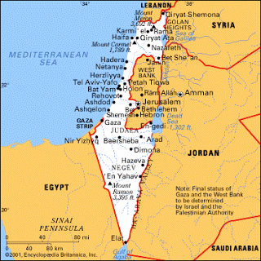
ORIGINAL BORDERS
2019 BORDERS
What is the land that God promised to Israel?
In regards to the land that Jehovah has promised Israel, Genesis 15:18 declares to Abraham; “To your descendants I give this land, from the river of Egypt to the great river, the Euphrates.” God later confirms this promise to Abraham’s son Isaac and Isaac’s son Jacob (whose name was later changed to Israel). When the Israelites were about to invade the Promised Land, God reiterated the land promise, as recorded in Joshua 1:4, “Your territory will extend from the desert to Lebanon, and from the great river, the Euphrates—all the Hittite country—to the Great Sea on the west.”
According to Genesis 15:18 and Joshua 1:4 the land God gave to Israel included: everything from the Nile River in Egypt to Lebanon (south to north) and everything from the Mediterranean Sea to the Euphrates River (west to east). Translated today, Jehovah gave Abraham and his descendents all of the land Israel currently possesses, all of the land of the Palestinians (the West Bank and Gaza), all the land of Jordan, some of Egypt, Syria, Iraq and Saudi Arabia.
The God of Abraham, Isaac and Jacob will fulfill His eternal and unchangeable covenant with Israel while nations have “altered” the boundaries and seized the promised territory, nevertheless, the Lord shall not be mocked. (Galatians 6:7)

Slide 5
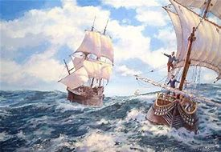
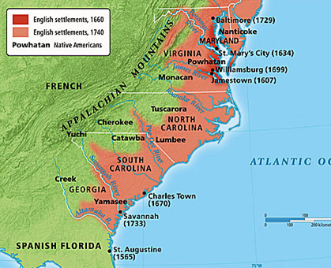
On 26 April 1607, after an unusually long voyage of 144 days over the Atlantic Ocean, 3 ships and 105 men and boys made landfall at the southern edge of the mouth of the Chesapeake Bay.
Robert Hunt (1568-1608), clergyman of the Church of England, was Chaplain of the expedition that founded Jamestown, Virginia. He held the title and functioned in the same position for the new settlement.
After lighting a candle and lifting his voice in public thanksgiving and prayer for their journey, the settlers planted a cross at Cape Henry (April 29th). With grateful hearts, Reverend Hunt and the pilgrims then proclaimed a covenantal decree with God.
Raising his hands to heaven, Reverend Hunt claimed the land for country and king and consecrated the continent to the glory of God.
In COVENANT language he declared, “…from these very shores the Gospel shall go forth to not only this New World, but the entire world.”

Slide 6
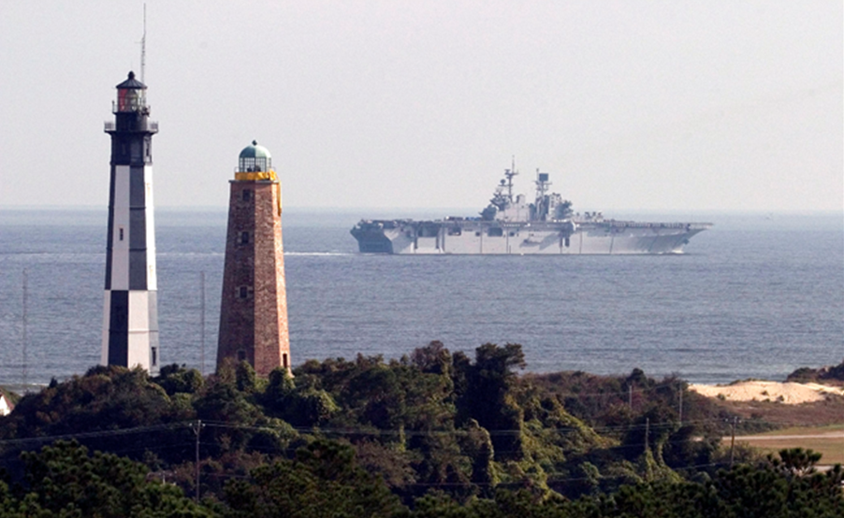
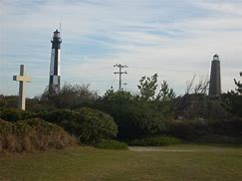
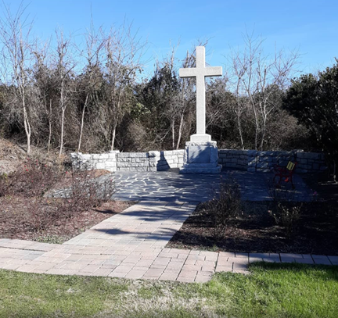
Cape Henry Lighthouse

Slide 7
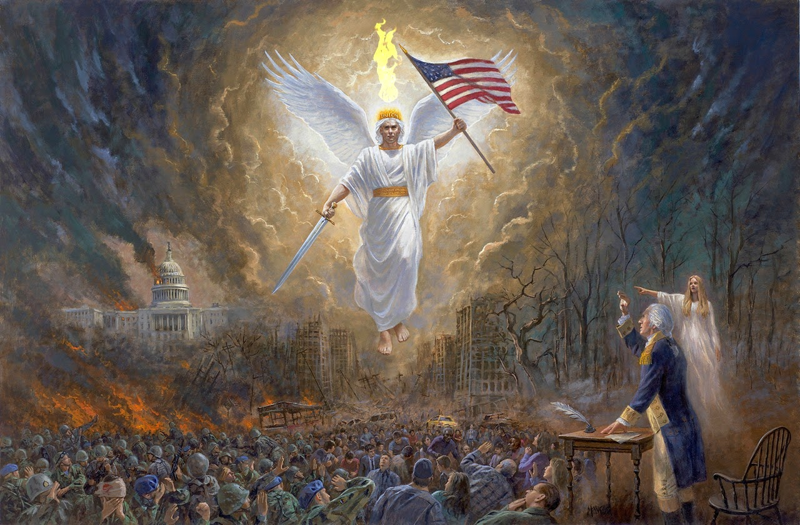
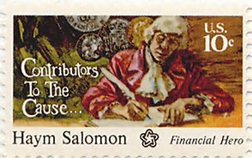
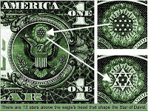
"Instantly a light as of a thousand suns shone down from above me, and pierced and broke into fragments the dark cloud which enveloped America. At the same moment the angel upon whose head still shone the word Union, and who bore our national flag in one hand and a sword in the other, descended from the heavens attended by legions of white spirits. These immediately joined the inhabitants of America, who I perceived were well nigh overcome, but who immediately taking courage again, closed up their broken ranks and renewed the battle.
(September 28-October 19, 1781): without food, uniforms and supplies, Washington's troops were close to mutiny. Washington determined that he needed at least $20,000 to finance the campaign. When Robert Morris (Superintendent of Finance) told him there were no funds and no credit available, Washington gave him a simple but eloquent order: "Send for Haym Salomon". Salomon raised $20,000, through the sale of bills of exchange. With that, and a personal loan by Robert Morris, Washington conducted the Yorktown campaign which proved to be the final battle of the Revolution.

Slide 8
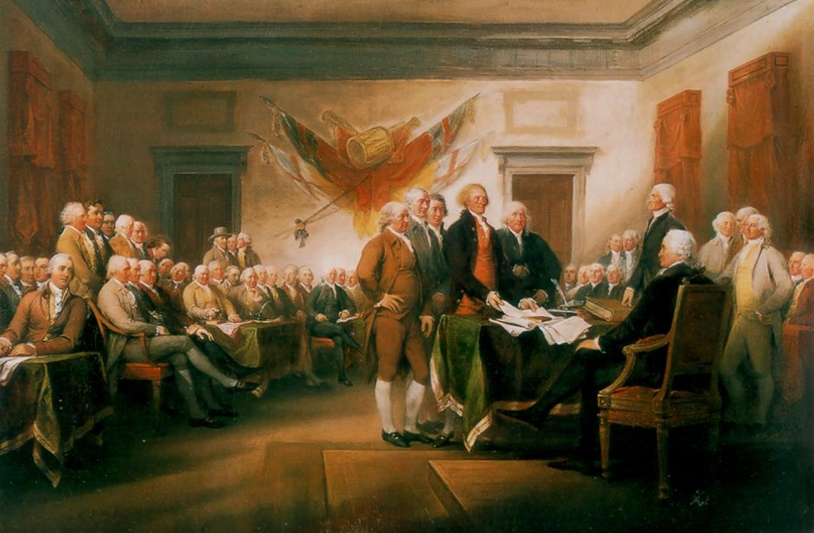
DIVINE PROVIDENCE
Original 13 Colonies
Of the 56 men who signed the Declaration of Independence, nearly half (24) held seminary or Bible school degrees
THREE MOST QUOTED SOURCES OF THE FOUNDING FATHERS

Slide 9
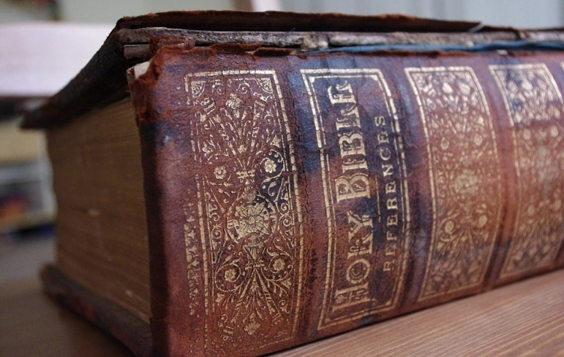
Professors Donald S. Lutz and Charles S. Hyneman examined nearly 15,000 writings of the 55 writers of the U.S. Constitution, including newspaper articles, pamphlets, books and monographs, and discovered that the Bible, especially the book of Deuteronomy, contributed 34 percent of all direct quotes made by the Founders. When indirect Bible citations were included, the percentage rose even higher.
Benjamin Franklin wrote to the editor of the Federal Gazette, April 8, 1788: “I beg I may not be understood to infer, that our general Convention was divinely inspired when it formed the new federal Constitution … yet I must own I have so much faith in the general government of the world by Providence, that I can hardly conceive a transaction of such momentous importance to the welfare of millions now existing, and to exist in the posterity of a great nation, should be suffered to pass without being in some degree influenced, guided and governed by that Omnipotent, Omnipresent, Beneficent Ruler in whom all inferior spirits live & move and have their being.”
Alexander Hamilton wrote of the Constitution in his “Letters of Caesar,” 1787: “Whether the New Constitution, if adopted, will prove adequate to such desirable ends, time, the mother of events, will show. For my own part, I sincerely esteem it a system, which, without the finger of God, never could have been suggested and agreed upon by such a diversity of interests.”
https://www.wnd.com/2016/09/what-book-did-founding-fathers-most-often-quote/#hD3LfLA1LXAxHrTK.99

Slide 10
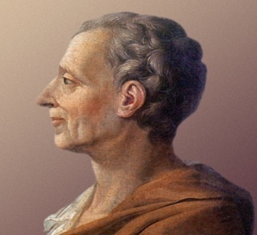
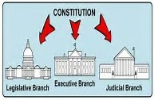
Baron de La Brède et de [Montesquieu]
Political scientist Donald Lutz found that Montesquieu was the most frequently quoted authority on government and politics in colonial pre-revolutionary British America, cited more by the American founders than any source except for the Bible. Following the American revolution, Montesquieu's work remained a powerful influence on many of the American founders, most notably James Madison of Virginia, the "Father of the Constitution". Montesquieu's philosophy required a clearly defined and balanced separation of powers.
He quoted Isaiah 33: 22, “for the Lord is our Judge, the Lord is our lawgiver and the Lord is our King” as the basis in forming an ideal government. At the Constitutional Convention of 1787, James Madison argued that if God governs that way, we should do the same, so he proposed the plan to divide the central government into the three branches that we have today.

Slide 11
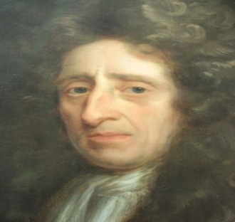
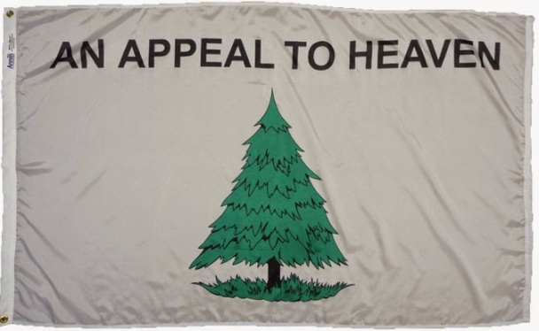
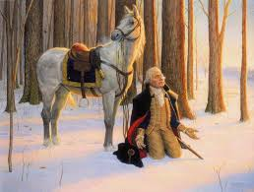
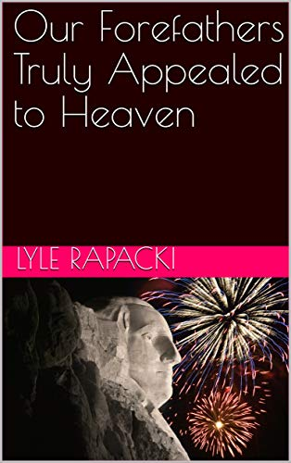
John Locke
Eminent political philosopher John Locke argued that when all other political and individual methods of resisting tyranny are exhausted, only an “appeal to heaven” remains.
“And where the body of the people, or any single man, is deprived of their right, or is under the exercise of a power without right, and have no appeal on earth, then they have a liberty to appeal to heaven…” The slogan “An Appeal to Heaven” is less dramatic than “Give me Liberty or give me Death,” but in its own way it is equally forceful and evocative. It is a call to action couched in the words of a philosopher rather than a politician.
The “appeal to heaven” motto was fashioned into a famous patriot flag, sometimes known as the “Pine Tree Flag.” The flag flew over a squadron of six cruisers under George Washington.
Dr. Lyle Rapacki
https://www.amazon.com/Our-Forefathers-Truly-Appealed-Heaven

Slide 12
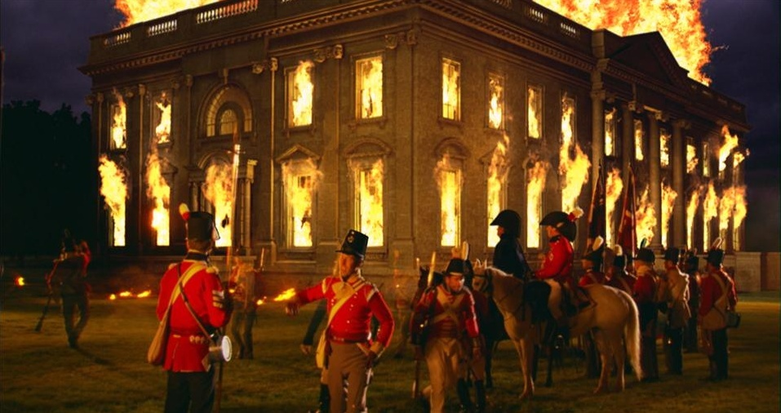
The Burning of Washington was a British invasion of Washington, D.C., the capital of the United States, during the War of 1812. On August 24, 1814, after defeating the Americans at the Battle of Bladensburg, a British force led by Major General Robert Ross burned down multiple buildings, including the White House (then called the Presidential Mansion), the Capitol building, as well as other facilities of the U.S. government. The Burning of Washington marks the only time since the American Revolutionary War that a foreign power has captured and occupied the United States capital.

Slide 13
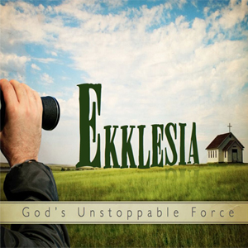
The Heaven of Heavens is for God, but He put us in charge of the Earth
Psalm 115: 16 (MSG)
RESTORATION OF KINGDOM VALUES

Slide 14
FORMATION:
Matthew 16: 18 - ¹⁸ And I tell you, you are Peter [Greek, Petros — a large rock] and on this rock [Greek, petra — Jesus being the Son of God] I will build My *church (and the powers of Hell ‘the authorities of the infernal region’) shall not overpower it [or be strong enough to prevail against it].
STRUCTURE:
Ephesians 4:11-12 - ¹¹ And [His gifts to the *church were varied and] He Himself appointed some as apostles [special messengers, representatives], some as prophets [who speak a new message from God to the people], some as evangelists [who spread the good news], and some as pastors and teachers [to shepherd and guide and instruct], ¹² [and He did this] to fully equip and perfect the saints (God’s people) for works of service, to build up the body of Christ [the *church].
*Ecclesia (Ekklesia): ἐκκλησία ekklēsía, ek-klay-see'-ah; from a compound of G1537 and a derivative of G2564; a calling out. In Christian theology: Latin ecclesia, from Greek Ekklesia had an original meaning of "assembly, congregation, council", literally "convocation".

Slide 15
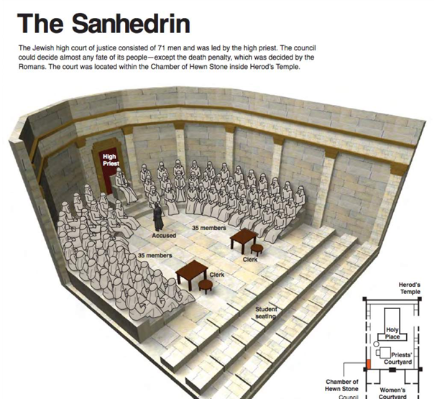
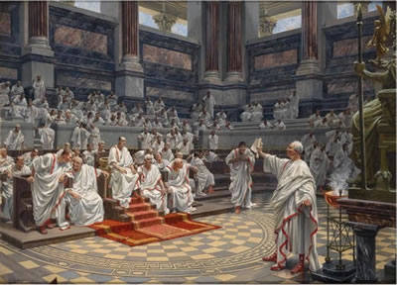
The ecclesia or ekklesia (Greek: ἐκκλησία) was the principal assembly of the democracy of ancient Athens. It had the final say on legislation and the right to call magistrates to account after their year of office.
The Church, the ekklesia
The ekklesia or Church was founded and established by Jesus Christ, Yahshua, almost 2000 years ago. It was a government established by the anointed King and appointed to His "little flock" to look after His Kingdom.
The word 'church' in the New Testament is translated from the Greek word 'ekklesia' which comes from two words 'ek' meaning 'out' and 'kaleo' meaning to 'call.' An ekklesia or 'calling out' was not just an assembly. The word ekklesia was a political term, not a religious term. Jesus was the King and the Bible used the term ekklesia for a good reason. In classical Greek "ekklesia" meant "an assembly of citizens summoned by the crier, the legislative assembly.“
In Israel the government assembly, like that of the early Roman Senate, had no power to make law. By the time of Christ both the Senate of Rome and the Sanhedrin of Judea had become bodies of legislative rulers exercising authority over the people. They had become a corporate body of "lawmakers" ruling the people through vast bureaucratic systems under a central ruling office of executive power.

Slide 16
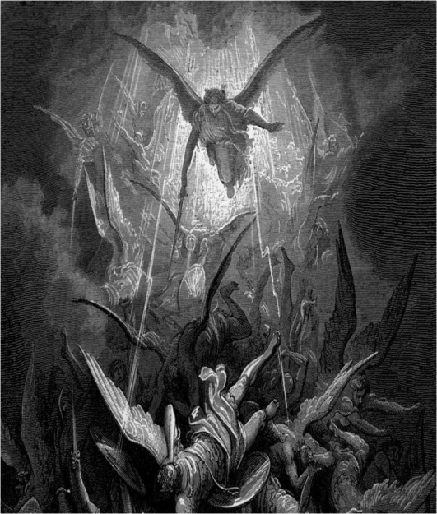
Ephesians 6:12 (KJV)
For ^{G3754} we ^{G2254} wrestle ^{G3823} not ^{G3756}against ^{G2076} ^{G4314} flesh ^{G4561} and ^{G2532} blood, ^{G129}but ^{G235} against ^{G4314} principalities, ^{G746} against ^{G4314} powers, ^{G1849} authorities, ^{G1849} against ^{G4314} the rulers ^{G2888} of the darkness ^{G4655} of this ^{G5127} world, ^{G165} against ^{G4314}spiritual ^{G4152} wickedness ^{G4189} in ^{G1722} high ^{G2032} places.
Ruler listed in reference to demonic angels

Slide 17
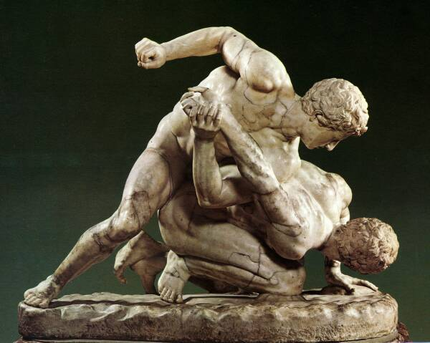
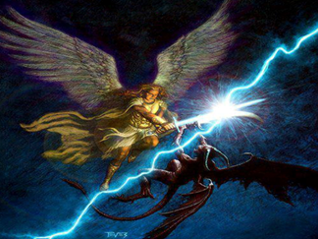
Second Heaven
Principalities (G746): beginning (40x), principality (8x), corner (2x), first (2x), miscellaneous (6x). beginning, origin; the first place, principality, rule, magistracy of angels and demons. Chief (in various applications of order, time, place, or rank):—beginning, corner, (at the, the) first (estate), magistrate, power, principality, principle, rule.
Powers (G1849): power (69x), authority (29x); the sign of regal authority - a crown. The leading and more powerful among created beings superior to man, spiritual potentates; the power of rule or government (the power of him whose will and commands must be submitted to by others and obeyed).
Rulers (G2888) used one time in NT, Lord of the world, prince of this age; the devil and his demons; of the darkness (G4655) of ignorance respecting Divine things and human duties, and the accompanying ungodliness and immorality, together with their consequent misery in hell; persons in whom darkness becomes visible and holds sway.
spiritual (G4152) belonging to a spirit, or a being higher than man but inferior to God; wickedness (4189) depravity, i.e. (specially), malice; plural (concretely) plots, sins:—iniquity, wickedness. Evil, purposes and desires in high (G1722) a primary preposition denoting (fixed) position (in place, time or state) places (G2032 used one time in NT, the lower heavens, of the stars (the 2nd heaven)

Slide 18
THE LEGISLATIVE (RULING) BODY OF CHRIST – THE “EKKLESIA”
II Corinthians 5: ¹⁷ Therefore if any person is [in-grafted] in Christ (the Messiah) he is a new creation (a new creature altogether); the old [previous moral and spiritual condition] has passed away. Behold, the fresh and new has come!
²¹ He made Christ who knew no sin to [judicially] be sin on our behalf, so that in Him we would become the righteousness of God [that is, we would be made acceptable to Him and placed in a right relationship with Him by His gracious loving kindness] in Christ.
Acts 17: ²⁸ For in Him we live and move and have our being; as even some of your [own] poets have said, For we are also His offspring.
Ephesians 2: ⁶ And He raised us up together with Him and made us sit down together [giving us joint seating with Him] in the heavenly sphere [by virtue of our being] in Christ Jesus (the Messiah, the Anointed One).
Matthew 6: ⁹ Pray, therefore, like this: Our Father Who is in heaven, hallowed (kept holy) be Your name. ¹⁰ Your kingdom come, Your will be done on earth as it is in heaven.

Slide 19
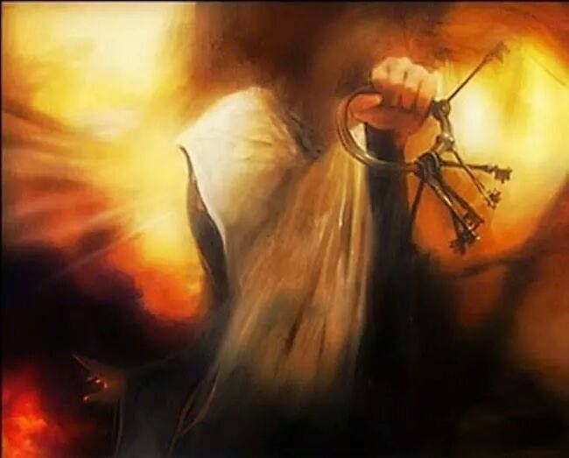
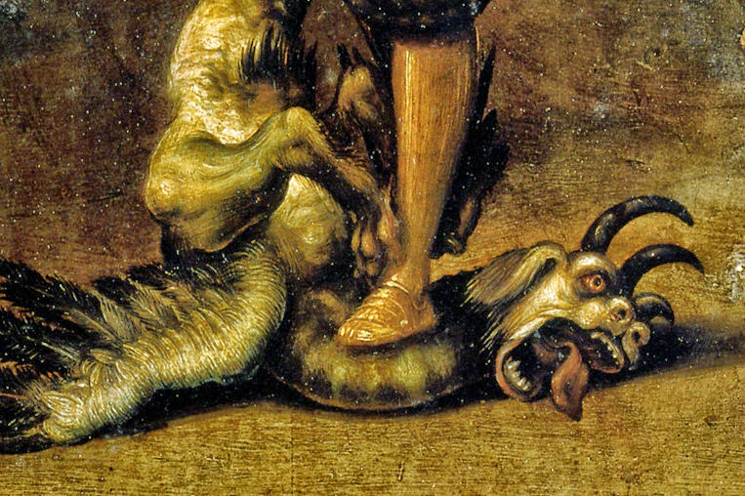
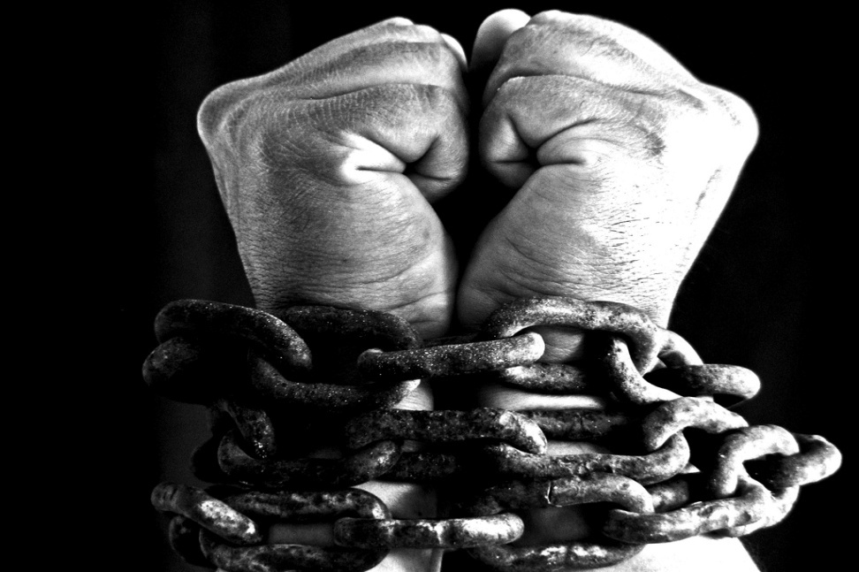
Quoting Jesus: “I have given you authority [that you now possess] to tread on serpents and scorpions, and [exercise authority] over all the power of the enemy (realm of evil); and nothing will [in any way] harm you.” [Luke 10:19]
As the legislative body of His Kingdom on earth, once again, Holy Spirit is beginning to reveal our power and authority (Gensis 2) to decree (Job 22: 28), open doors and shut doors (Isaiah 22: 22), bind and loose (Matthew 18: 18) and know that our King is watching over His word to perform it (Jeremiah 1: 12).
Leviathan and Python

Slide 20
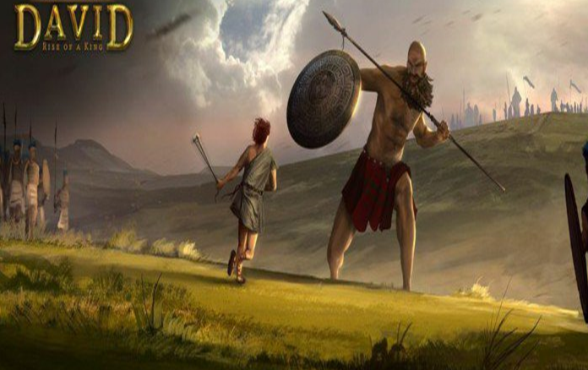
2 Samuel 21: ¹⁵ Once again there was a battle between the Philistines and Israel. David went down with his men to fight against the Philistines, and he became exhausted. ¹⁶ And Ishbi-Benob, one of the descendants of Rapha, whose bronze spearhead weighed 7.5 lbs. and who was armed with a new sword, said he would kill David. ¹⁷ But Abishai son of Zeruiah came to David’s rescue; he struck the Philistine down and killed him.
Then David’s men swore to him, saying, “Never again will you go out with us to battle, so that the lamp of Israel will not be extinguished.”

Slide 21
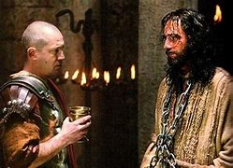
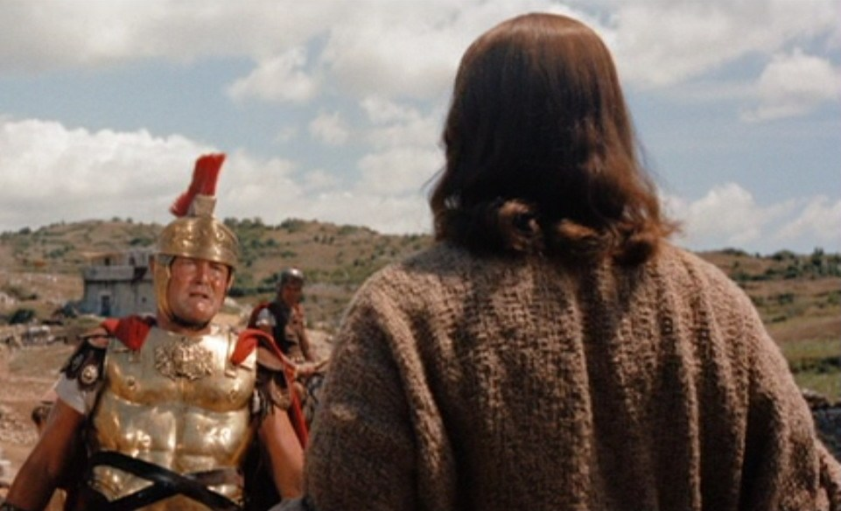
Sword and the New anointing with a Scepter
Matthew 26:53, “…Don’t you realize that I could ask my heavenly Father for angels to come at any time to deliver me? And instantly he would answer me by sending twelve armies of the angelic host to come and protect us. (The Passion Translation) 72,000 battled hardened host
John 17: 24, ““Father, I ask that you allow everyone that you have given to me to be with me where I am then they will see my full glory — the very splendor you have placed upon me because you have loved me even before the beginning of time.. (The Passion Translation)
Matthew 8: “⁵When Jesus had entered Capernaum, a centurion came to him, asking for help. ⁶ “Lord,” he said, “my servant lies at home paralyzed, suffering terribly.” ⁷ Jesus said to him, “Shall I come and heal him?” ⁸ The centurion replied, “Lord, I do not deserve to have you come under my roof. But just say the word, and my servant will be healed. ⁹ For I myself am a man under authority, with soldiers under me. I tell this one, ‘Go,’ and he goes; and that one, ‘Come,’ and he comes. I say to my servant, ‘Do this,’ and he does it.” ¹⁰ When Jesus heard this, he was amazed and said to those following him, “Truly I tell you, I have not found anyone in Israel with such great faith.

Slide 22
The Faith of the Centurion (Gentiles – Ekklesia) 2021-2023 5780-5783
As a solider the centurion authority in the chain-of-command and he displayed faith in the God of Israel. His behavior demonstrates several qualities stewardship:
The welfare of those under his authority should be a top priority of a good leader
This account does not begin with a record of the centurion touting his own power but rather with an account of his love for and commitment to those under his authority: “A certain centurion’s servant, who was dear unto him, was sick, and ready to die” (Luke 7:2). The centurion’s deep concern for the welfare of his servant is reflected in the intensity of his appeal to Jesus.
An authority’s power should be an afterthought
When a person in authority is primarily concerned that other people recognize his position and respect his power, he is out of balance. It is best for an authority to focus on his responsibilities under God and how he may honor other authorities.
An authority must view himself as being under authority.
The centurion did not first say that he was a man in authority, but rather, “. . . I also am a man set under authority . . .” (Luke 7:8a). This declaration communicates humility and expresses a sense of accountability to God and others for the use of that power. Those in leadership should see themselves as members of a long line of individuals who are responsible for directing and protecting others. Leaders should recognize that they are under authority as well, and they will be held accountable for how they exercise their power.

Slide 23
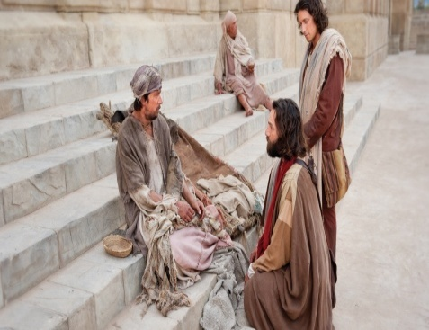
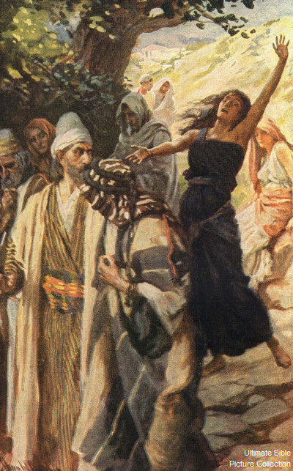
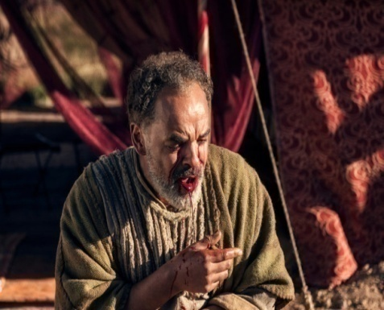
Manifesting Power to Authority of the Ekklesia
Acts 3: “³ When he noticed Peter and John going into the temple, he begged them for money. ⁴ Peter and John, looking straight into the eyes of the crippled man, said, “Look at us!” ⁵ Expecting a gift, he readily gave them his attention. ⁶ Then Peter said, “I don’t have money, but I’ll give you this—by the power of the name of Jesus Christ of Nazareth, stand up and walk!”
Acts 16: “¹⁷ She kept following us, shouting, “These men are servants of the Great High God, and they’re telling us how to be saved!” ¹⁸ Day after day she continued to do this, until Paul, greatly annoyed, turned and said to the spirit indwelling her, “I command you in the name of Jesus, the Anointed One, to come out of her, now!” At that very moment, the spirit (Python) came out of her!”
Acts 5: “³ God revealed their secret to Peter, so he said to him, “Ananias, why did you let Satan fill your heart and make you think you could lie to the Holy Spirit? ⁵ The moment Ananias heard those words, he fell over dead.”
⁹ Peter told her, “Why have you agreed together to test the Spirit of the Lord? I hear the footsteps of those who buried your husband at the door—they’re coming here to bury you too!” ¹⁰ At that moment she dropped dead at Peter’s feet.”

Slide 24
The Blood Covenant:
Divine Providence:
a) Founding Fathers
Restore Kingdom Values
The Ekklesia
Shift in Power and Authority:
Sword – Scepter
The “Vision”

Slide 25
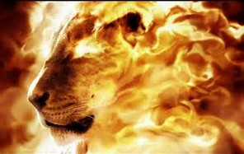
THANK YOU APOLSTLE WENTROBEL – GOD BLESS

